Slide 1
STUDY OF ANALGESIC USING HOT PLATE OR TAIL FLICK METHOD

Slide 2
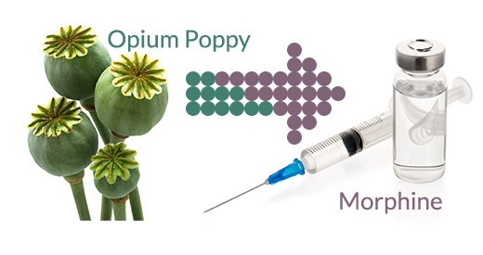

AIM : To demonstrate the analgesic effect of morphine using hot plate / tail flick method
It is an opioid analgesic which exerts its action by inhibiting the release of excitatory transmitters at primary afferents – at Substantia gelatinosa of dorsal horn which is exerted through interneurons- gating of pain
Morphine

Slide 3
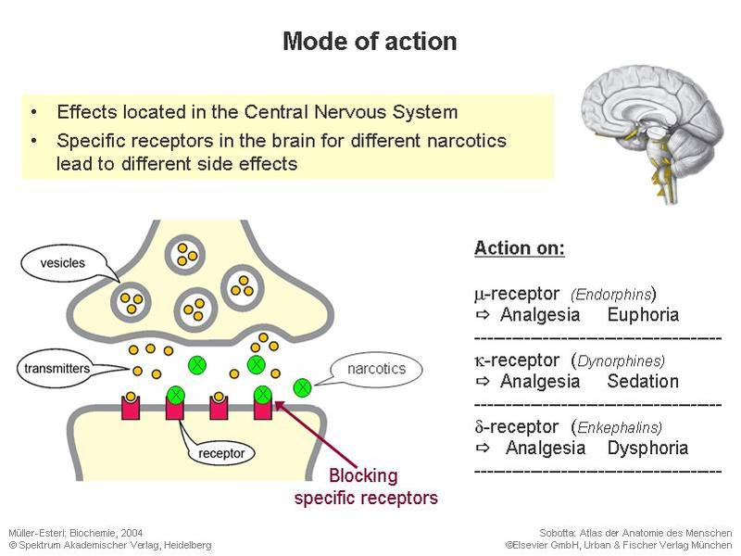

Slide 4
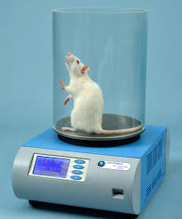
HOT PLATE METHOD
It is a pain test used in testing the effectiveness of analgesics by observing the reaction to pain caused by heat.
PROCEDURE:
Animal is kept on the surface to be heated
The temperature of the hot plate is set using a thermoregulated water-circulated pump.
Time of latency is recorded which is time period between the zero point , that is when animal is placed on hot plate surface and time when animal licks its paws or jumps off.

Slide 5
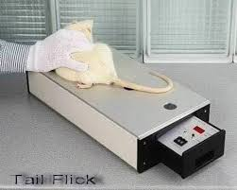
TAIL FLICK METHOD
Its principle is similar to hot plate and is used to test the effectiveness of analgesic.
PROCEDURE :
The light beam is made incident on
animals tail and timer starts.
When the animal flicks its tail the timer
stops and the latency period which is
the measure of pain threshold is found out.

Slide 6
Observation table
Treatment | Time (mins)
 | 0 |  | 30 |  | 60 |  | 90 |  | 120
 | Latency Time (sec) | % Increase in latency | Latency Time (sec) | % Increase in latency | Latency Time (sec) | % Increase in latency | Latency Time (sec) | % Increase in latency | Latency Time (sec) | % Increase in latency
Vehicle control | 5.46 |  | 4.99 |  | 5.72 |  | 5.20 |  | 4.95
Morphine (5mg/kg) | 6.36 | 15.57 | 9.38 |  | 12.41 |  | 14.83 |  | 13.53
% Increase in latency time = Latency time of morphine – latency time of vehicle
--------------------------------------------------------------------- X 100
Latency time of Vehicle

Slide 7
Graphical Representation

Slide 8
Conclusion
The average % increase in latency time after administration of Morphine to jump up of the hot plate was found to be __ as compared to control. This shows that morphine is an analgesic and acts by increasing the perception as well as threshold of pain.

